Slide 1

INTRODUCING RAMSETU

Slide 2
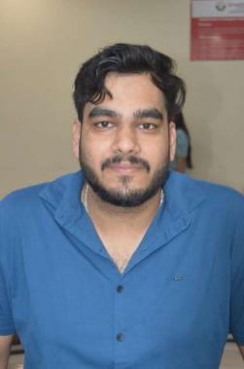
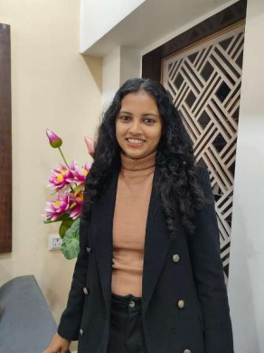
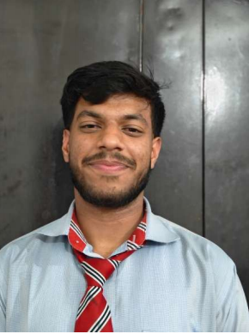
TEAM MEMBERS(DBMS-V-T077)
LEADER
MEMBER 2
MEMBER 3
PRIYANSHU,BANSAL-23021126
PRAGYA,KATIYAR -230221393
KRISHNA,GOEL-23021181
MENTOR :-
NAME- DR. VIJAY SINGH SIR
RAMSETU – A BRIDGE OF CARE AND HOPE

Slide 3

RAMSETU-Wellfare

Slide 4

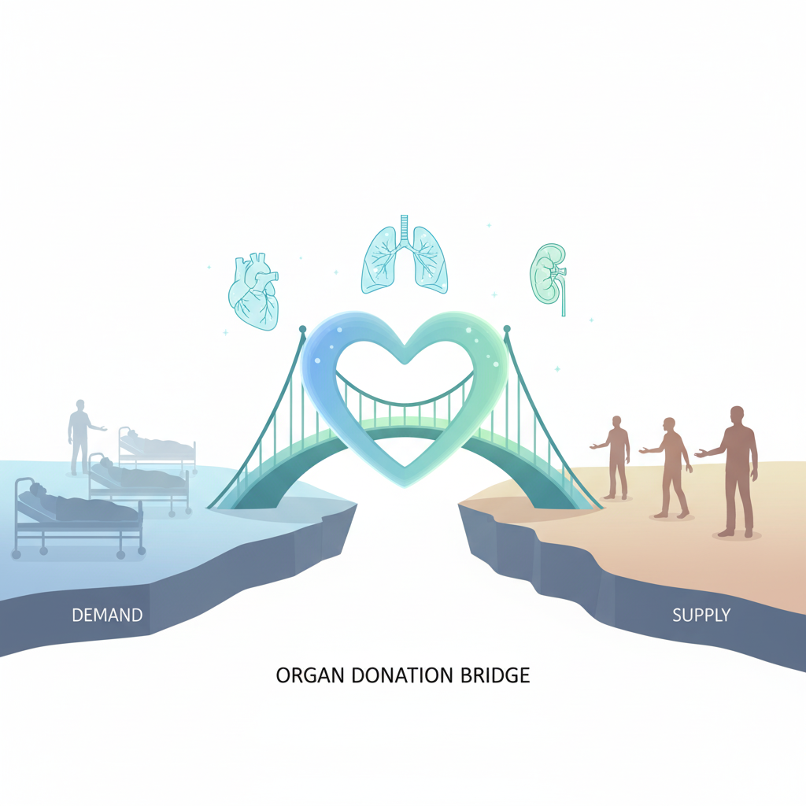

OBJECTIVE
The RamSetu Organ Donor App aims to act as a life-saving digital bridge by connecting verified organ donors with patients in need. It focuses on reducing delays through efficient database-driven matching, ensuring trust with admin verification, and providing a scalable, user-friendly platform for hospitals and healthcare networks.

Slide 5
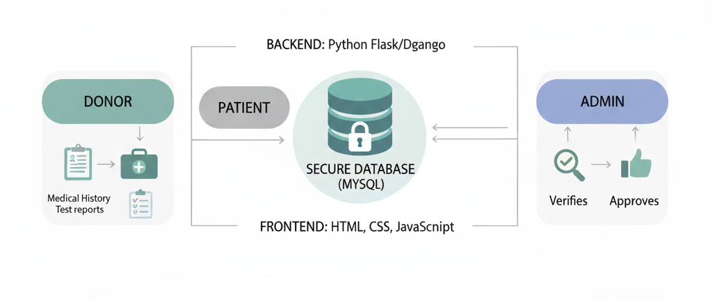
FEATURES
Secure Registration –
Donor & patient sign-up with document uploads
Admin Verification –
Manual checks for trust & authenticity
Smart Matching –
Database-driven donor–patient pairing
Emergency Support –
Quick retrieval to save critical time
Secure Access –
Login with email verification
Instant Alerts –
Real-time notifications & updates
Scalable Platform –
User-friendly and hospital-ready

Slide 6
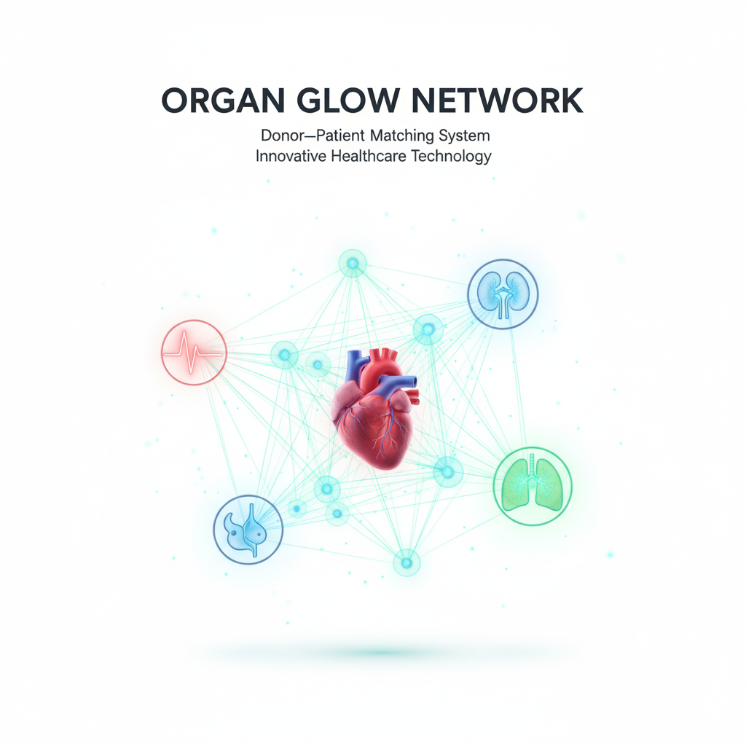



TECHNINAL STACK- RAMSETU
Frontend
Tech-
React + TypeScript + Vite + Tailwind CSS
Backend
Tech -
Node.js + Express + MongoDB
For Authentication -
JWT -based authentication middleware
File Uploads -
Multer for handling uploads (User,Donor,Patient,DonationRequest,Documents,Match,OTP)
Status Management -
Admin can verify/reject requests

Slide 7
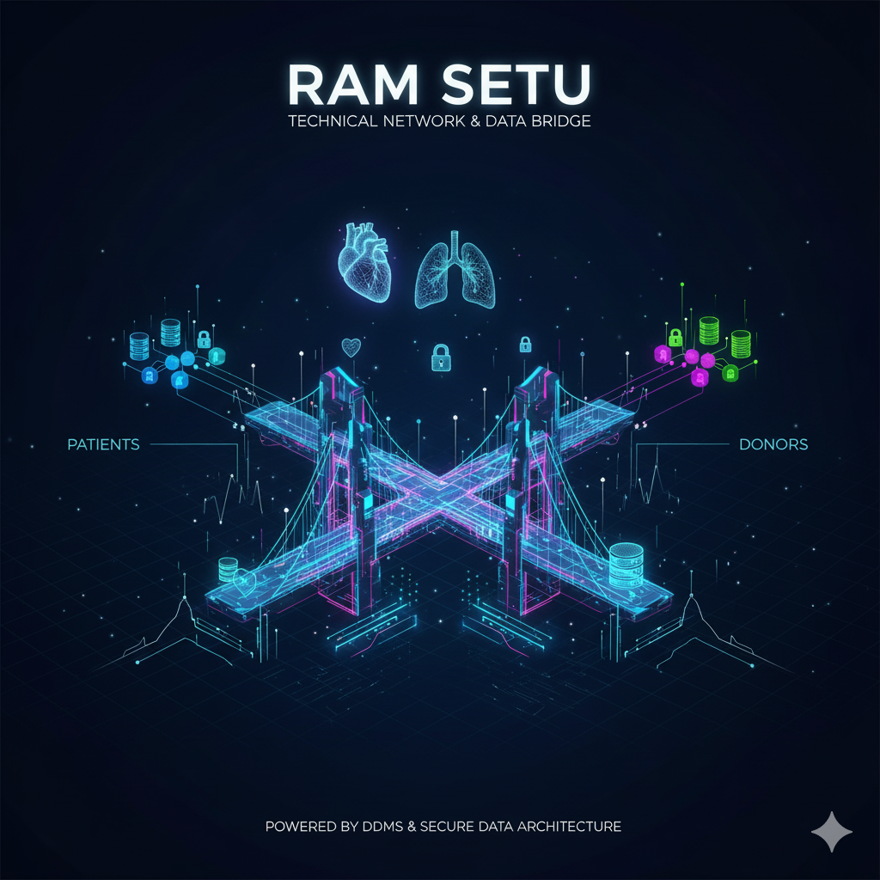
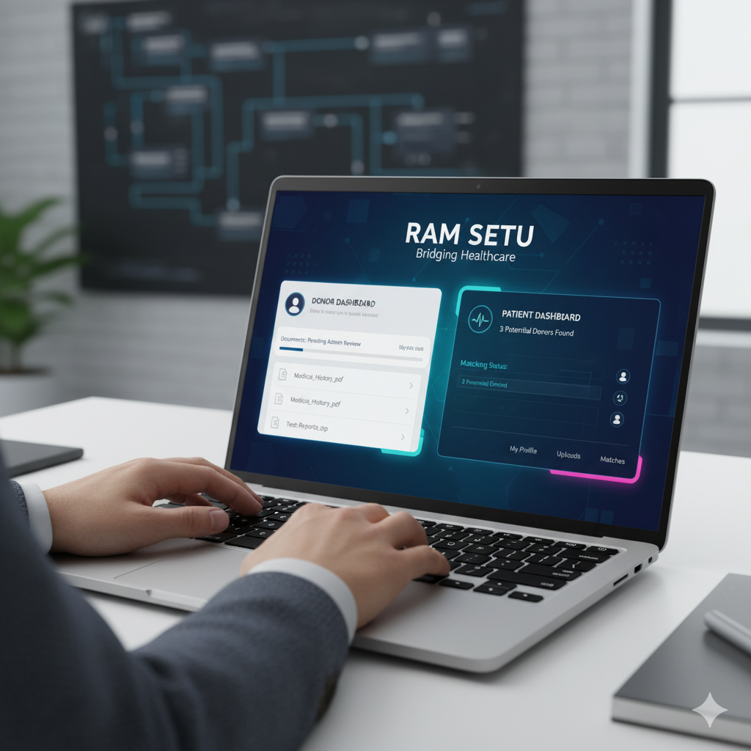
OVERVIEW OF PROJECT
RamSetu is a web-based platform designed to act as a digital bridge between organ donors and patients in need of transplants, with an admin overseeing verification. The system ensures secure registration, document verification, and efficient matching to reduce delays in emergencies.

Slide 8
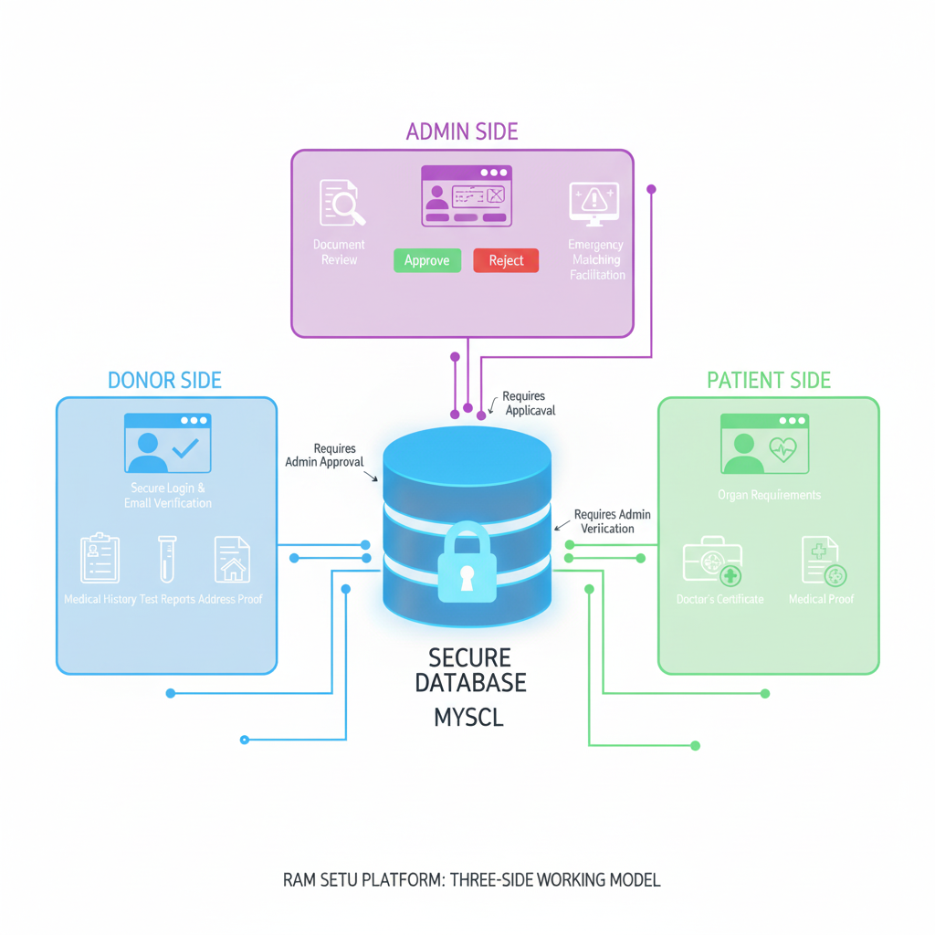
PROJECT IDEA
Registration
Donor: Creates account, submits medical history, test reports & address proof.
Patient: Creates account, uploads doctor certificate & medical documents.
Data is stored in database (pending verification).
Verification
Admin reviews donor and patient documents.
Approves or rejects based on authenticity.
Only verified accounts move to active database.
Matching
Patient requests matched against verified donor records.
Matching system checks organ type, blood group & compatibility.
Admin validates the suggested match.
Communication
Donor and patient receive notifications after approval.
Hospitals and doctors are informed to proceed.
Execution & Monitoring
Hospital manages the final transplant procedure.
Admin continues to monitor system, users & new registrations.

Slide 9
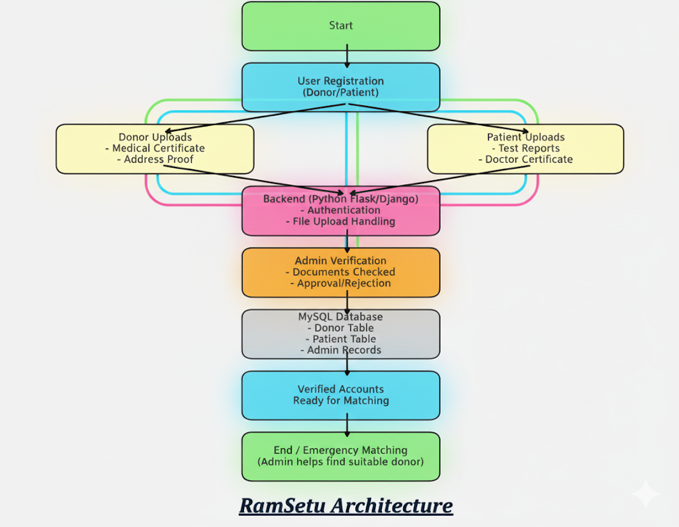
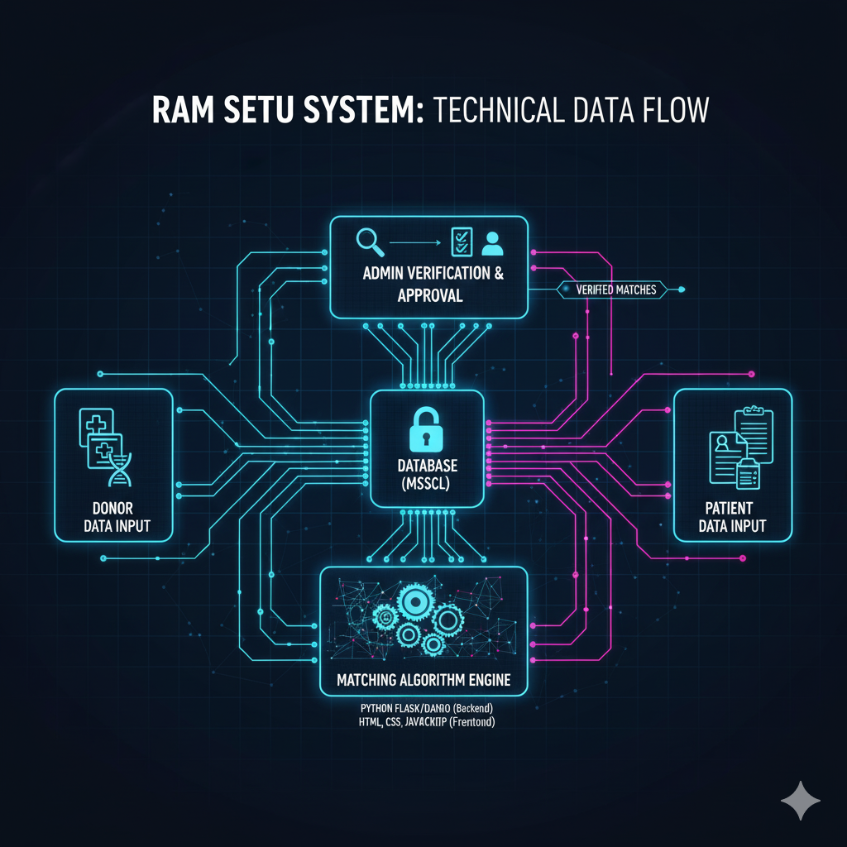
WORKFLOW & ARCHITECTRE

Slide 10
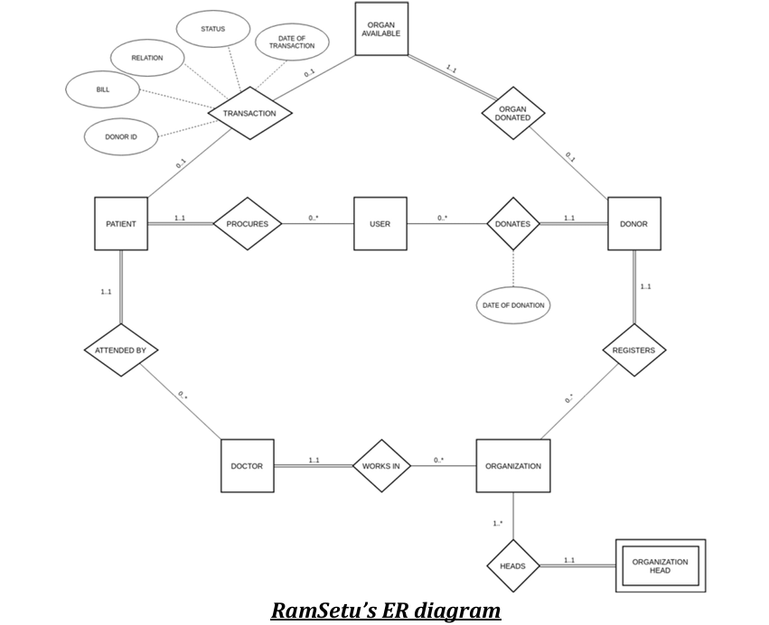
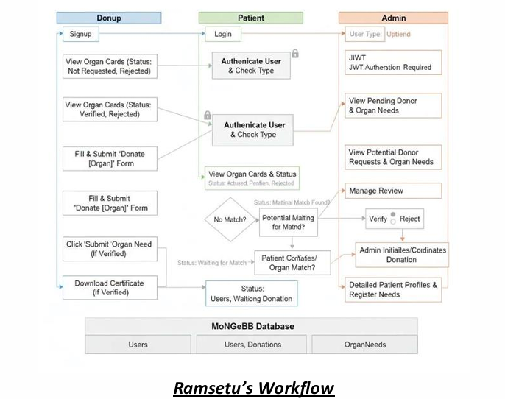
WORKFLOW & ARCHITECTRE

Slide 11
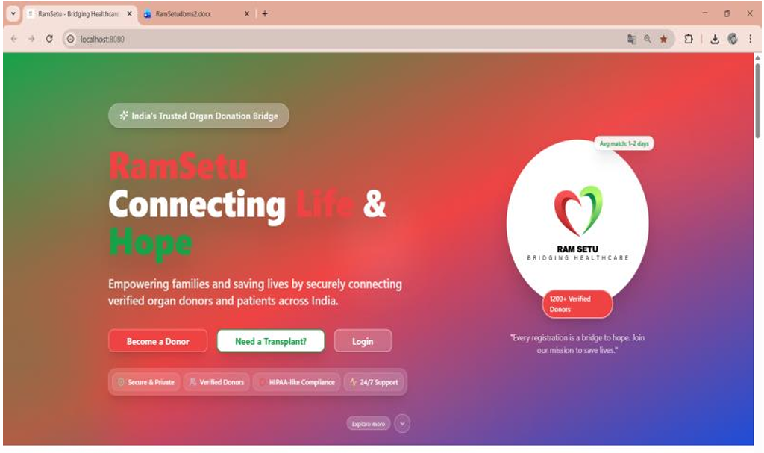
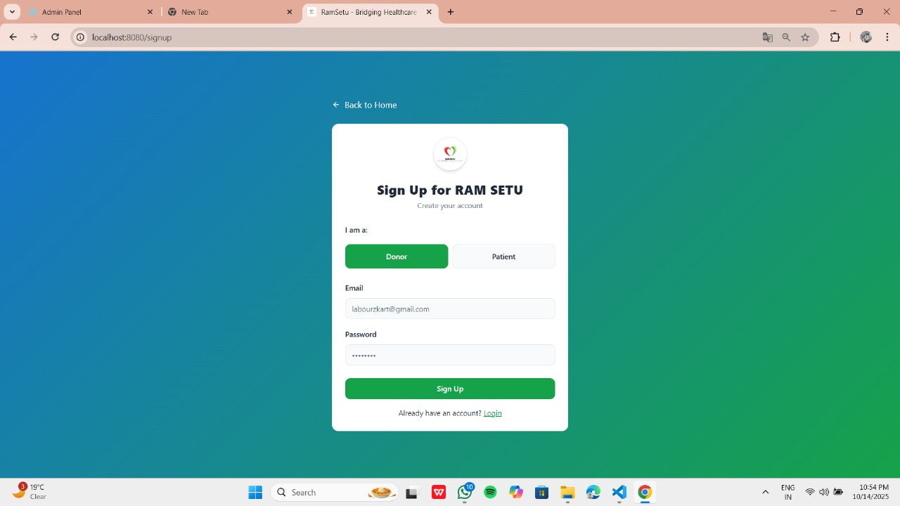
SNIPPETS OF PROJECT
When registered as DONOR :-
Site Dashboard
Login UI

Slide 12
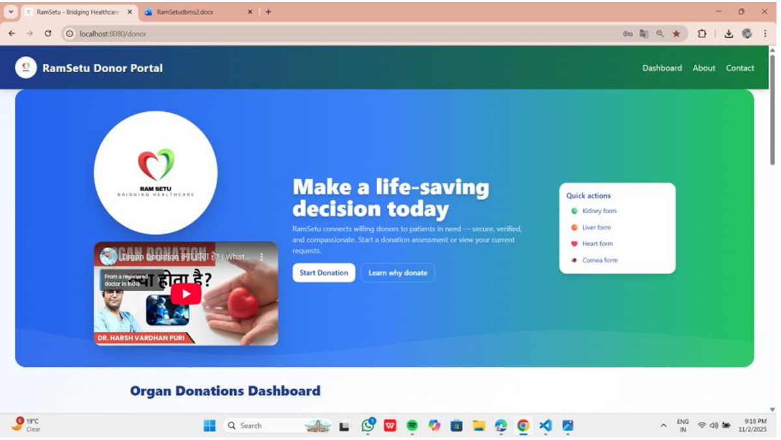
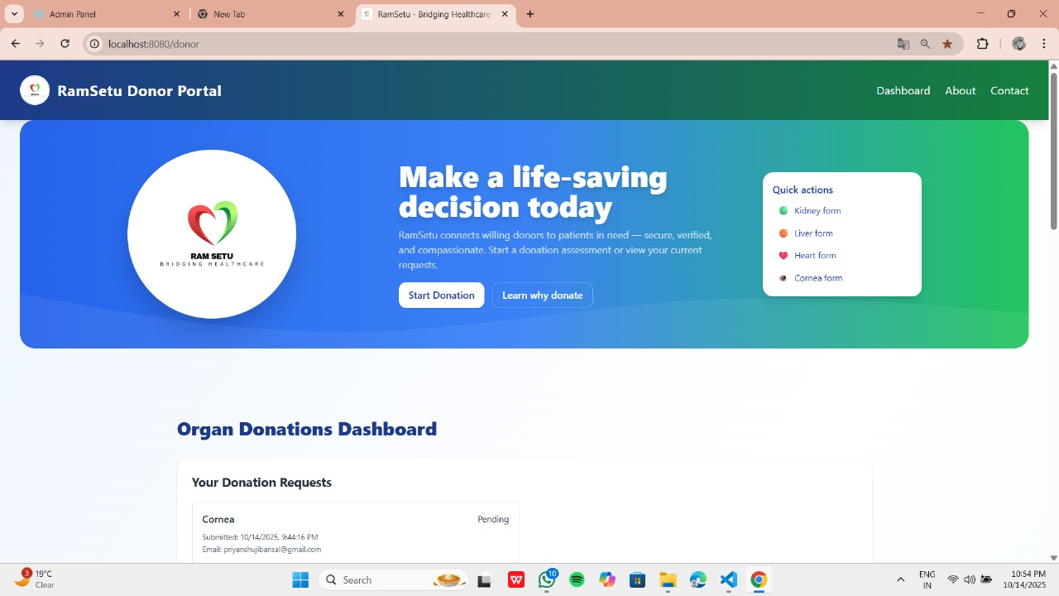
SNIPPETS OF PROJECT
Donor Panel
Donation Requests

Slide 13
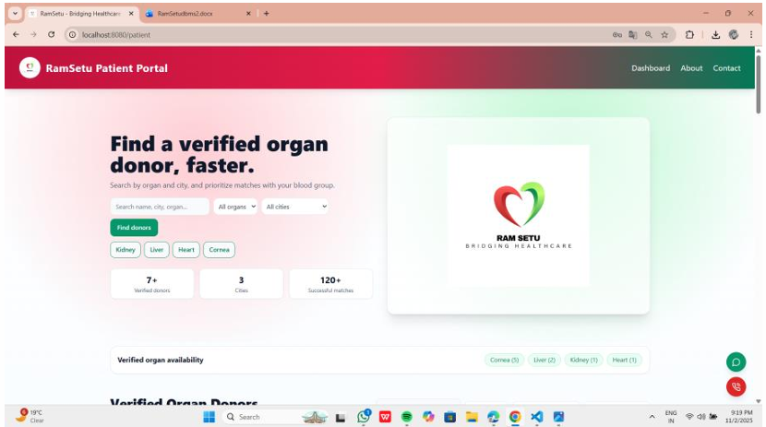
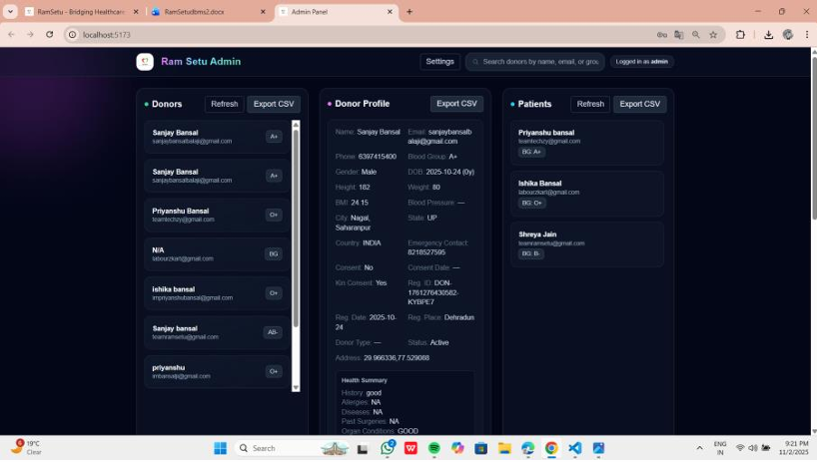
SNIPPETS OF PROJECT
Patient Panel
Admin Panel

Slide 14
Roles and Responsibilities
Priyanshu Bansal – Team Lead
Technical
Database schema design & backend development (MONGODB & EXPRESS).
Signup and Login Page frontend + backend
Integration of donor–patient matching system.
Other
Team coordination & task distribution.
Ensuring project milestones and deadlines are met.
Pragya Katiyar – Team Member
Technical
Frontend development (REACT, Vite, Typescript).
Designing donor & patient registration modules and functionality.
Other
Preparing project documentation & presentation.
Assisting in UI/UX improvement.
Krishna Goel – Team Member
Technical
Dynamic landing page and admin functionality.
Matching logic implementation & testing.
Other
System testing & bug reporting.
Supporting admin dashboard requirements.

Slide 15
FUTURE SCOPE
AI-Based Donor-Recipient Matching: Implement machine learning algorithms to improve donor-patient compatibility and prediction.
Real-Time Notifications: Add SMS/email/push notifications for status updates, new matches, and reminders.
Mobile Application: Develop a cross-platform mobile app for easier access and engagement.
Analytics Dashboard: Provide advanced analytics for admins to monitor trends, success rates, and bottlenecks.
Multi-Language Support: Add localization to make the platform accessible to a wider audience.
Integration with Hospitals: Connect directly with hospital systems for automated verification and updates.
Blockchain for Data Security: Use blockchain technology to ensure transparency and security in organ donation records

Slide 16


THANKYOU
THE GIFT OF LIFE, MADE POSSIBLE WITH US

